Slide 1

Final Project : Generative AI for Work & Research
Build a website for a consultancy company
This project showcases a multi-page website, complete with a dynamic chatbot and a seamless contact form, built using cutting-edge AI tools.
ID
by Isabelle Jacqueline Mathilde DEVAUX

Slide 2
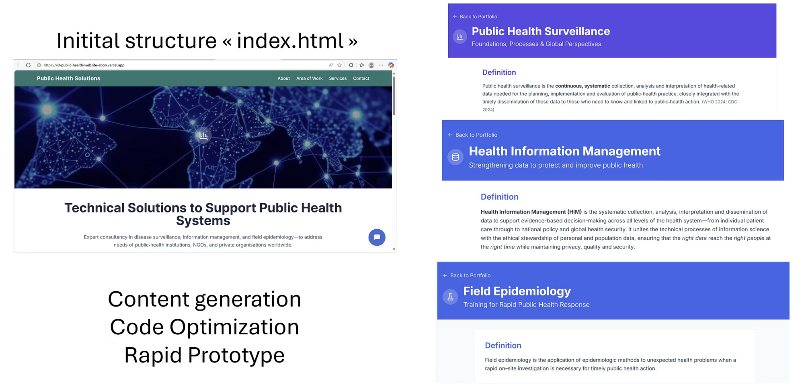
Step 1: Crafting HTML Pages with ChatGPT

Slide 3

Step 2: Building the Website with Vercel V0.dev
The project transitioned to Vercel V0.dev for seamless website construction. This platform enabled the effective connection of the main pages and integration of three distinct work areas.
The main 'index.html' page was linked to various sub-pages, creating a cohesive site structure.
Dedicated sections for Public Health Solutions and other consultancy areas were established.
Explore the live site: Public Health Solutions
Public Health Solutions

Slide 4
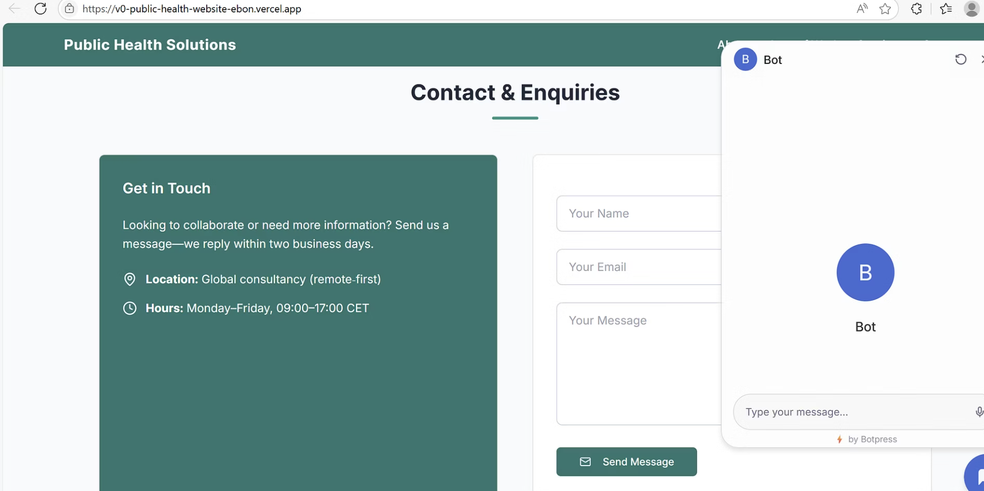
Step 3: Integrating Chatbot & Contact Form
Chatbot with Botpress
An AI-powered chatbot was integrated using Botpress, enhancing user engagement and providing instant support.
Contact Form with Resend.com
A reliable contact form was implemented, powered by Resend.com, requiring the creation of an API key for secure communication.

Slide 5





Discussion: Limitations & Opportunities
ChatGPT
Limitations: Requires precise specifications for content, accuracy checks are crucial. Opportunities: Rapid content generation and prototyping.
GitHub.com
Limitations: Challenges connecting multiple pages to the main page initially. Opportunities: Simple file architecture for basic projects.
Vercel V0.dev
Limitations: Complex file architecture, backend work needed for Resend. Opportunities: Capable of producing sophisticated multi-page websites.
Botpress
Limitations: Guidance needed for advanced Botpress Studio features. Opportunities: Ability to refine instructions for bot behavior.

Slide 6

In a nutshell, AI tools can be useful to epidemiologist and still on the way to learn!
Links
Presentation in Gamma.com: https://gamma.app/docs/Final-Project-Generative-AI-for-Work-Research-qhiao8a9o7tpx9q
Website: Public Health Solutions

